Slide 1
Kacha Bazar . Com A ONLINE SHOPING SYSTEM

Slide 2



Presented by
Md Asaduzzaman Masum
ID :- CSE 06307433
Md Shamim
ID :- CSE 06307456
Taufiq Anam Fahim
ID :- CSE 06307436

Slide 3
Overview
Introduction
Contribution
Requirements
Feasibility
Screen Shots Of The Site
Future Scope
Conclusion

Slide 4
Introduction
The purpose of the project is to come up with electronic commerce system that is simple and secure for users
Clients can view products browse for more information about the product
Select items and collect them in shopping cart then buy products online
System will be able to manage customer’s data , data about products in store and transactions
Customer’s information will be kept confidential. But online administrator can view them

Slide 5
Contribution
Md Shamim – 30%
Md Asaduzzaman Masum - 30%
Taufiq anam Fahim – 25%
Abid Ahmed -15%

Slide 6
Requirements
Secure access of confidential data
24 / 7 availability
Better component design to get better performance at peak time
Advertisement space where it will effectively catch the customer’s attention and as a source of revenue
More Payment gateways
Dynamic price model by which prices can be changed based on demand and supply

Slide 7
Feasibility
Technical Feasibility
This is concerned with specifying equipment and software that will successfully satisfy the user requirement. In examine
Technical feasibility ,
Configuration of the system is given more importance than the actual make of hardware.
How many workstations are required
How these units are interconnected so that they could operate and communicate smoothly

Slide 8
Feasibility
Operational Feasibility
It is mainly related to human organization and political aspects. The points to be considered are :
what changes will be brought with the system ?
what organizational structures are distributed ?
What new skills will be required ?

Slide 9
Feasibility
Economical Feasibility
Economic analysis is the most frequently used technique for evaluating the effectiveness of a proposed system. More frequently known as cost-benefit analysis.
The procedure is to determine the benefits and savings that are expected from a proposed system and compare them with costs
If benefits outweigh costs , a decision is taken to design and implement the system

Slide 10
Feasibility
Social Feasibility
Social feasibility is a determination of whether a proposed project will be acceptable to the people or not.
Management Feasibility
It is a determination of whether a proposed project will be acceptable to management. If does not accept a project or gives a negligible support to it ; the analyst will tend to view the project as a non feasible one

Slide 11
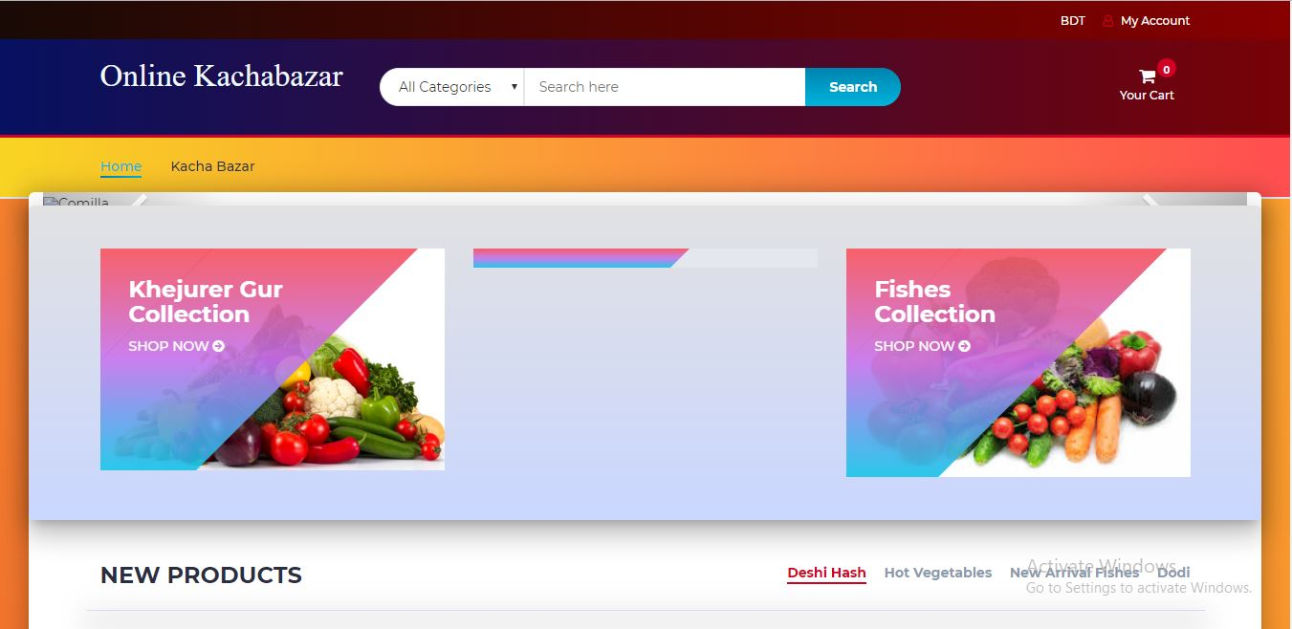
Screen Shots Of The Site
Front View

Slide 12
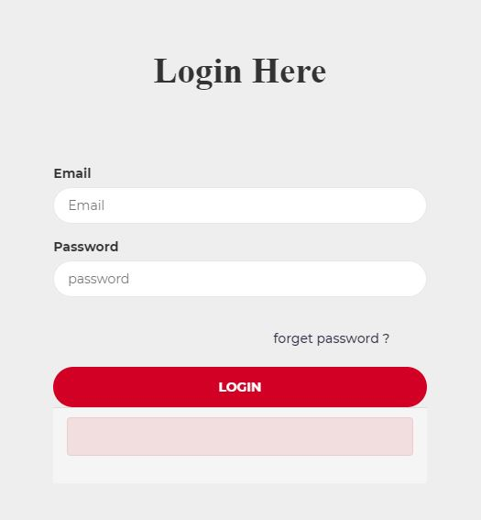
Screen Shots Of The Site
Login process

Slide 13
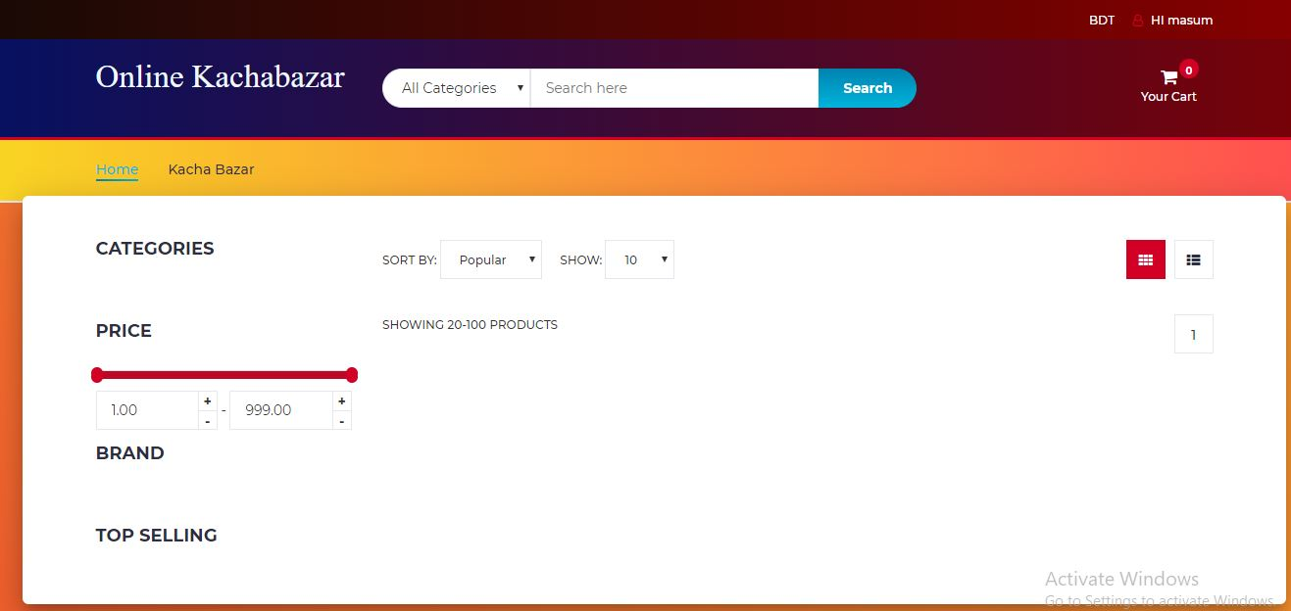
Screen Shots Of The Site
Infront View

Slide 14
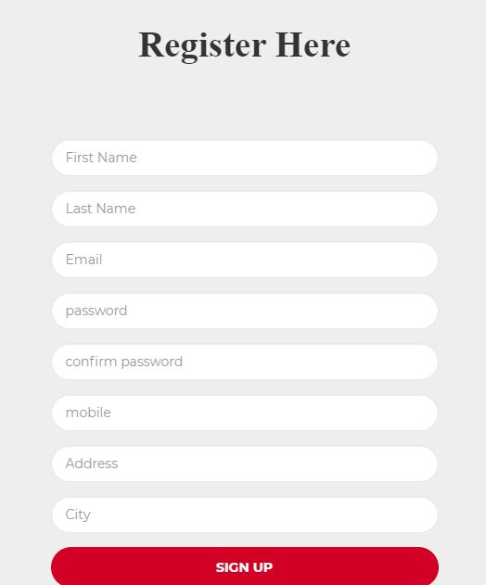
Screen Shots Of The Site
Registration

Slide 15
Future Scope
The project made here is just to ensure that this product could be valid in today real challenging world. Here all the facilities are made and tested.
Currently the system works for limited number of administration to work. In near future it well be extended for many types of insuring policies so that efficiency can be improved

Slide 16
Conclusion
This is to conclude that the project that I undertook was worked upon with a sincere effort. Most of the requirements have been fulfilled up to the mark and the requirements which have been remaining ,can be completed with a short extension

Slide 17

Thank u for having with us?

